Slide 1
DISCO Plenary Meeting
Mathieu Bouet

Slide 2
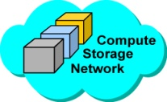
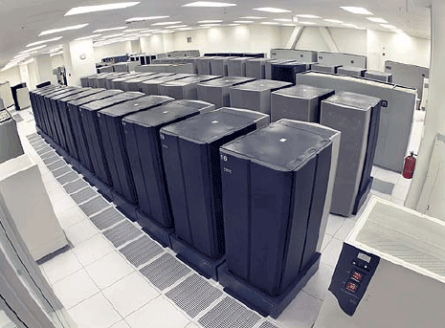
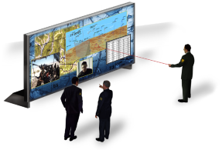
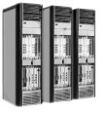
DISCO use case and Next generation SDN
Paris
Datacenter
London
Datacenter
New York
Datacenter
Heterogeneous and Time-varying resources
(resources / cost/ / failures)
Enterprise WAN
Mission Critical WAN
Private Operated WAN
Integrated Cloud Management
Private
Clouds
Users & Services
User
Distributed SDN controller
Role attribution and instance placement
Flow and service dependence analysis
Network wide admission control and
scaling decisions
App.
App.
Control Plane
Controller
instance
Controller
instance
Controller
instance
Controller
instance
Controller
instance
Virtual Network functions
Elastic allocation and placement
Dynamic configuration and controllability
New scalable appliances for DPI and
caching
Cipher
Load balancer
Cache
DPI
Data Plane
Switch

Slide 3
WP1 – Requirements & System Architecture
Objectives
Explore the potential business cases and services that SDN enables (TCS, INRIA, 6WIND)
Analyze the main use case in details and derive system requirements (all)
Identify the interactions between the different architecture elements (all)
Define a flexible and modular architecture (all)
Identify the important issues and trade-offs (all)
Task 1.1 Analysis of new SDN paradigms (INRIA, TCS, 6WIND)
Task 1.2 Use case applications and system requirements (TCS, all)
Task 1.3 System architecture & Challenges identification (6WIND, all)

Slide 4
Deliverables & Milestones
Milestone | Date
M1: New SDN paradigms analysis and survey of recent contributions | M3
M2: Business and cases description | M3
M3: Analytical and experimental feedback from the other work packages | M15
Deliverable | Date | Type | Editor | Contributors
D1.1: Preliminary DISCO architecture | M6 | Doc | TCS | All
D1.2: Final DISCO architecture | M24 | Doc | 6WIND | All

Slide 5
M1: New SDN paradigms analysis and survey of recent contributions
B. Astuto et al., `A Survey of Software-Defined Networking: Past, Present, and Future of Programmable Networks’ to appear in IEEE Com. Surveys & Tutorial, http://hal.inria.fr/hal-00825087
History of SDN
Open Signaling, Active Networking, DCAN, 4D, NETCONF, Ethan
Main current Architecture
OpenFlow, ForCES
Forwarding
Forwarding table
Rules installation
Controllers (see table III)
Centralized vs distributed
Multi level (e.g., region, proxies…)
Granularity and reactivity vs proactivity
Code verification and debugging
API
Southbound communication
Northbound communication
SDN Development Tools (emulation vs simulations vs software switches (see table I) vs hardware switches (see table II))
SDN Applications
Enterprise Networks, Data Centers, Infrastructure-based Wireless Access Networks, Optical Networks, Home & Small Business)
Research Challenges
Controller & switch design, Internetworking/heterogeneous networks, ICN
+ état de l’art – programmation du réseau (Frenetic, One Big Switch) - Damien
+ état de l’art controleurs distribués - Mathieu
+ virtual switchs + 6WIND (1 page) - Bruno
+ 1 page sur l’environnement industriel (Midokura, Nuage, Big Switch, OpenDaylight, VMWare NX, Contrail, NEC) – 6WIND + TCS
Positionnement par rapport à Optical SDN (Cian, ADVA…)
Deadline: fin avril

Slide 6
M2: Business and cases description
Applications
VoD (~CDN), potentiellement streaming (autres applications: partage de données médicales)
Maximiser la satisfaction du plus grand nombre de clients pour un ensemble de ressources données
Donner à l’opérateur la capacité d’allouer des ressources supplémentaires
Deployments
Opérateur avec quelques gros DC et une multitude de micro POP: multi-level DC
~5G networks
Services
Transcodage
Pay per view
User classes (critical, premium , BE…)
Requirements
Délai de bout en bout (RTT)
Gigue
PER
Dispo
Network Management (API NaaS)

Slide 7
Description of work
DISCO approach & progress. DISCO will foster its use case around critical applications (for resilience, differentiated flow managements, etc.) and content delivery. In particular, DISCO will propose a NaaS API to enable content distribution application to determine the resources that are available in the network and to exploit them, for instance requesting caches at specific locations. These functionalities will lay on the DISCO SDN control plane and on the DISCO optimization methods of the data plane. (page 12)
Task 1.2 Use case applications and system requirements (TCS, all) This task will study in details the main use case on a distributed Cloud infrastructure for resilient and secured services. (page 19)

Slide 8
High-level service description
Objective:
provide a NaaS API that enables to support:
Video hosting service
(e.g. Youtube)
Video producers (end-users’ smartphone, applications…)
Video consumers (end-users’ smartphone, applications…)

Slide 9
First high-level service’s properties and functionalities
Elastic w.r.t. to quantity of users
Resilient to infrastructure disruptions
Offers differentiated services (e.g. premium/critical users and best-effort users)
Offers video treatment services (e.g. watermarking, re-encoding, …)
Ensures data confidentiality

Slide 10
Deployment context
Datacenter 1
Constrained Datacenter
SDN Ctrl
Enterprise WAN
SDN sw
Mission-critical WAN
Mission-critical WAN
Enterprise WAN
Video producers and consumers
Datacenter 2
Video producers and consumers

Slide 11
Service deployment example
Datacenter 1
Constrained Datacenter
Front end
Encryption
Back end
Enterprise WAN
Encryption
DPI
Encryption
Mission-critical WAN
Mission-critical WAN
Enterprise WAN
Encryption
DPI
Front end
Video producers and consumers
Back end
Datacenter 2
Video producers and consumers

Slide 12
Service deployment example
Datacenter 1
Constrained Datacenter
Technical issues:
How to provide a rich NaaS API for distributing content?
Where Virtualized Network Functions can be placed?
How to optimize network and VNF performances through dynamic multi-core allocation?
How to make the SDN control plane resilient (distribution)?
How to perform network-wide admission control?
…
Front end
Encryption
Back end
Enterprise WAN
Encryption
DPI
Encryption
Mission-critical WAN
Mission-critical WAN
Enterprise WAN
Encryption
DPI
Front end
Video producers and consumers
Back end
Datacenter 2
Video producers and consumers

Slide 13
Content delivery
Contents are huge and greedy (e.g., video, medical imagery)
Access is controlled (e.g., pay-per-view, sensitive information)
Per-consumer adaptation (e.g., screen size, privacy)
Content producer
Content producer
Content storage
Access control
(e.g., AAA)
Content
Transformer
(e.g., crypto, transcoding)
Content
consumer
Content
consumer
Content
consumer
Content
consumer

Slide 14
Medical data example
Data produced in medical centers but stored in regional/national database
One-time access to data only
Client data consumption workflow
Authentication and accounting (virtual machines to grant and log access to data)
On-the-fly generation of the data (encryption with the ephemeral key for the session)
Transmission of the data to the consumer

Slide 15
VoD example
Data produced in production centers but distributed in continental/country/region/PoP caching facilities
One-time access to video and pay per view
Authentication mechanism
Accounting
on-the-fly encryption
Device adaptation
Transcoding to adapt to the device
Mobility support
Transcoding to adapt to network condition
Dynamic flow table updates
Popular contents
Caching mechanism to avoid overloading the network

